Slide 1


RISKGUARD
Erode Sengunthar Engineering College
(An Autonomous Institution)
Perundurai, Erode - 638057
A Multi-Modal AI Deepfake Detection System
UNDER THE GUIDANCE OF
Mr. R. Narendran, B.E., M.E., (Ph.D).,
Assistant Professor,
Department of Information Technology
PRESENTED BY
Abi Prasath R 730422205002
Harija A 730422205023
Hemabala S P 730422205030

Slide 2
Introduction
AI-generated media poses escalating threats to digital trust and public safety.
Deepfake images, cloned voices, AI-authored phishing text are increasingly realistic.
Traditional systems cannot distinguish authentic content from synthetic media.
Law enforcement and citizens need proactive, real-time detection tools.
RiskGuard provides a comprehensive multi-modal detection platform.
Combines local signal processing with cloud-based AI models.

Slide 3
Abstract
RiskGuard is a multi-modal AI deepfake detection system.
Detects synthetic content across image, voice, text, and video modalities.
Uses hybrid CPU + GPU architecture with 6-signal ensemble detection.
Blockchain evidence preservation via SHA-256, IPFS, and Merkle trees.
Flutter mobile app with real-time protection overlay for citizens.
FastAPI web dashboard for law enforcement investigators.
Achieves 70-92% image, 65-85% voice, and 70-88% text detection accuracy.

Slide 4
Need for the System
Rapid proliferation of AI-generated deepfake content across all media types.
Existing tools require manual content submission for analysis.
Single-modality detection leaves gaps in security coverage.
No integrated system combining detection with evidence preservation.
Citizens lack real-time protection during everyday app usage.
Law enforcement needs tamper-proof forensic evidence chains.

Slide 5
Problem Statement
Accurately distinguishing AI-generated content across multiple modalities.
Ensuring tamper-proof chain of custody for digital forensic evidence.
Providing real-time detection without requiring manual content submission.
Most existing solutions are limited to single modality (image OR video OR audio).
Processing delays of 10-60 seconds per item in current tools.
No proactive protection during browsing WhatsApp, Chrome, or Instagram.

Slide 6
Objectives
Build multi-signal ensemble detection for image, voice, text, and video.
Achieve 60-92% accuracy without requiring GPU hardware on detection path.
Implement blockchain evidence ledger with Merkle-batch anchoring.
Reduce per-record blockchain costs by up to 99.7% via Merkle batching.
Develop real-time protection overlay monitoring whitelisted applications.
Create dual-interface: Flutter mobile app + FastAPI web dashboard.

Slide 7
Existing System
Microsoft Video Authenticator, Deepware Scanner, Sensity AI — standalone tools.
Require users to manually upload suspicious content for verification.
Limited to single-modality analysis (image OR video OR audio).
Blockchain systems like Chainkit operate independently of detection.
Cloud-based GPU inference with significant processing delays.
No real-time, proactive protection during everyday app usage.

Slide 8
Limitations of Existing System
Manual, user-initiated analysis — threats during normal usage go undetected.
Single-modality — cannot cross-correlate signals across media types.
Slow processing (10-60 seconds per item) requiring cloud connectivity.
Blockchain evidence systems fragmented from detection workflow.
No offline detection capability available.
No proactive monitoring of messaging and social media applications.

Slide 9
Proposed System
RiskGuard: comprehensive multi-modal AI detection platform.
Proactive real-time overlay monitors whitelisted apps automatically.
Hybrid CPU + GPU architecture for local + cloud detection.
6-signal ensemble for images, 6-signal for voice, 4-signal for text.
Integrated blockchain evidence chain with Merkle-batch anchoring.
Operates on commodity 8 GB RAM hardware with optional cloud GPU.
Dual interface serving citizens (Flutter) and investigators (web dashboard).

Slide 10
Advantages of Proposed System
Multi-modal detection across image, voice, text, and video in one platform.
Real-time proactive protection through system overlay monitoring apps.
Hybrid local + cloud architecture enabling offline detection.
Merkle-batch anchoring reduces blockchain gas costs by 99.7%.
Live call monitoring with voice deepfake detection during phone calls.
URL verification with URLhaus threat feeds and community blacklists.
Processing under 200ms for voice chunks, under 150ms for local images.

Slide 11
System Architecture - Overview
Three-tier architecture: Flutter frontend, FastAPI backend, external services.
Mobile app communicates via HTTPS REST APIs with backend.
Backend processes AI detection across four modalities.
External services: HuggingFace, Google Colab, Pinata IPFS, Polygon blockchain.
System overlay runs independently via Android Accessibility Services.
Platform channels bridge native Android services with Flutter UI.

Slide 12
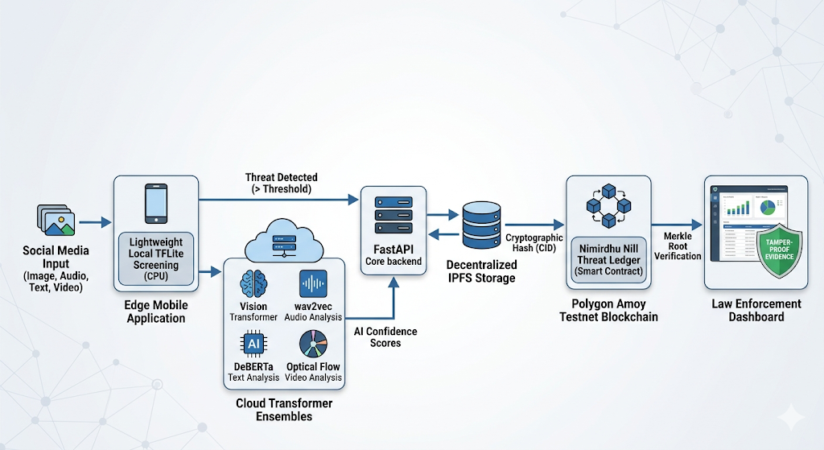
System Architecture Diagram

Slide 13
Image Analysis Module
6-signal type-adaptive weighted ensemble architecture.
Classifies images into photograph, digital art, or screenshot.
NPR (Noise Print Residual) detects camera sensor noise patterns.
DCT spectral analysis detects GAN/diffusion frequency fingerprints.
Haar wavelet decomposition analyzes multi-scale texture features.
Cloud CNN + HuggingFace classifiers for deep learning signals.
Graceful degradation: failed signals excluded, weights redistributed.

Slide 14
Image Detection Signal Weights
Signal weights dynamically adjusted based on image type:
Signal | Photo Weight | Art Weight | Technique
ONNX/Colab | 25% | 10% | CNN Binary Classifier
Cloud HF | 25% | 10% | HuggingFace AI Detector
NPR | 15% | 5% | Noise Print Residual
Wavelet | 15% | 5% | Haar Wavelet Decomposition
pHash | 10% | 5% | Perceptual Hashing (DCT)
DCT | 10% | 65% | DCT Spectral Analysis

Slide 15
Voice Analysis Module
6-signal hybrid CPU + GPU architecture with real-time streaming.
Processes 0.5-second chunks with analysis under 200ms per chunk.
LFCC (30%) — Linear Frequency Cepstral Coefficients.
CQT Phase Coherence (20%) — Constant-Q Transform analysis.
Modulation Spectrum (20%) — Temporal envelope analysis.
Pitch/F0 Contour (20%) — Autocorrelation-based tracking.
Statistical Moments (10%) — Higher-order amplitude analysis.
wav2vec2 GPU (40%) — Fine-tuned on ASVspoof2019 via ONNX.

Slide 16
Voice Detection Signal Architecture
Fusion: 60% local CPU + 40% Colab GPU (100% local when offline):
Signal | Weight | Technique
LFCC | 30% | Linear Frequency Cepstral Coefficients
CQT Phase | 20% | Constant-Q Transform Phase Coherence
Modulation | 20% | Temporal Envelope Modulation Spectrum
Pitch/F0 | 20% | Autocorrelation-based F0 Contour
Statistical | 10% | Higher-order Amplitude Moments
wav2vec2 | 40% | wav2vec2-base ASVspoof2019 ONNX

Slide 17
Text Analysis Module
4-signal ensemble combining cloud transformers with local methods.
DeBERTa (45%) — Fine-tuned on ChatGPT outputs for AI text detection.
RoBERTa (15%) — Short-text dampening fix for casual messages.
Binoculars Perplexity Proxy (20%) — Zero-shot LLM detection.
Local Statistical Analysis (20%) — Lexical diversity and patterns.
Independent phishing analysis layer with URL and urgency detection.
Risk score (0-100) with explanation for each analyzed text.

Slide 18
Video Analysis Module
2-signal temporal-aware pipeline reusing full image engine per-frame.
Per-frame image signal (60%) — Full 6-signal pipeline on sampled frames.
Temporal coherence signal (40%) — Farneback dense optical flow.
Samples at 3 FPS with maximum of 30 frames per video.
Deepfakes show abrupt flow variance due to face swap discontinuities.
Real video shows smooth, consistent optical flow patterns.

Slide 19
Blockchain Evidence Module
Follows "Immutable Chain of Custody" principle.
SHA-256 hash fingerprints the evidence file.
IPFS upload via Pinata provides decentralized storage with CID.
SQLite records off-chain metadata for efficient querying.
Multiple hashes combined into Merkle tree — only root stored on-chain.
Single Polygon transaction anchors entire batch via EvidenceAnchor contract.
Cost reduction: 83% for 10 records, 99.7% for 100 records.

Slide 20
Real-Time Protection Overlay
2300+ line Android system overlay for continuous security monitoring.
Leverages Accessibility Services to detect content in whitelisted apps.
Monitors WhatsApp, Chrome, Instagram, Telegram, Facebook.
Three surface modes: monitoring bubble, verdict card, call monitoring chip.
URL verification against URLhaus, community blacklist, heuristic screening.
Media detection captures dominant visible image for deepfake analysis.
Live call monitoring with real-time voice analysis during active calls.

Slide 21
URL Verification & Risk Scoring
Multi-layered threat intelligence for link safety assessment.
Normalizes URLs, checks community blacklist, queries URLhaus API.
Local heuristic screening for suspicious URL patterns.
Results cached for 120 seconds with confidence scoring.
Risk scoring: Call Pattern (25%), Voice (30%), Content (30%), History (15%).
Risk levels: LOW (≤30), MEDIUM (31-70), HIGH (71-100).

Slide 22
Cybercrime Investigation Dashboard
Web-based dashboard for law enforcement with real-time evidence management.
Live evidence table with Server-Sent Events (SSE) real-time updates.
Green pulsing LIVE badge showing active SSE connection status.
Toast notifications with sound alerts for new evidence.
Full evidence detail: SHA-256 hash, IPFS CID, Merkle proof, blockchain TX.
One-click batch anchoring and direct PolygonScan links.
Secure session-based authentication for investigators.

Slide 23
Technologies Used
Component | Technology | Purpose
Mobile Frontend | Flutter / Dart | Cross-platform app with overlay
Backend API | FastAPI (Python 3.11+) | Async REST API with Swagger UI
AI Detection | NumPy, SciPy, OpenCV | Zero-dependency signal processing
Cloud Models | HuggingFace Inference API | Transformer classification
GPU Inference | Google Colab + ONNX | wav2vec2, CNN classifier
Blockchain | web3.py, Polygon Amoy | On-chain evidence anchoring
Smart Contract | Solidity | Merkle root storage
IPFS | Pinata API | Decentralized evidence storage
Dashboard | FastAPI + Jinja2 + SSE | Real-time investigator interface
State Mgmt | Provider (Flutter) | Reactive state for protection

Slide 24
Working of the System
Image: Classifies input type → assigns signal weights → runs 6 signals concurrently.
Failed signals excluded, weights redistributed proportionally.
Weighted ensemble produces AI-generation probability with explanation.
Voice: Stereo-to-mono → resample 16kHz → VAD strips silence.
Real-time: 0.5s chunks processed under 200ms each.
Local CPU signals combined with optional cloud wav2vec2 inference.

Slide 25
Working of the System (Cont.)
Overlay: Detects whitelisted app → activates monitoring bubble.
Captures URLs for verification, media for deepfake analysis.
Call monitoring: transforms into voice analysis chip during calls.
Evidence: SHA-256 hash → IPFS upload → SQLite metadata.
Merkle tree aggregation → single Polygon transaction anchors batch.
Verification recomputes Merkle proof and compares to on-chain root.

Slide 26
Testing and Evaluation
Unit Testing — Individual modules validated in isolation.
Integration Testing — Frontend-backend-AI model communication verified.
System Testing — Full application tested with real-world inputs.
User Acceptance Testing — End-user evaluation of usability and UX.
Performance factors: response time, processing speed, reliability assessed.
Feedback-driven enhancements to UI and interaction design.

Slide 27
Test Case Results
Test ID | Input Type | Expected Output | Result
TC01 | Real Image | Classified as Real | Passed
TC02 | Deepfake Image | Classified as Fake | Passed
TC03 | Real Video | Real with Confidence Score | Passed
TC04 | Deepfake Video | Fake with Confidence Score | Passed
TC05 | Invalid File | Error Message | Passed

Slide 28
Results and Performance
Image detection: 70-92% accuracy on photographs.
Type-adaptive weighting prevents false positives on digital art.
Voice detection: 65-85% accuracy on full audio clips.
Real-time streaming support under 200ms per 0.5s chunk.
Text detection: 70-88% accuracy on long-form content.
Merkle batching reduces per-record costs by up to 99.7%.
Local image analysis completes under 150ms.

Slide 29
Conclusion
RiskGuard integrates multi-modal detection, blockchain evidence, and real-time protection.
Production-grade deepfake detection achievable on commodity hardware.
6-signal image ensemble with type-adaptive weighting prevents false positives.
Voice pipeline achieves real-time streaming under 200ms per chunk.
Blockchain evidence system reduces costs by 99.7% through Merkle batching.
Real-time overlay provides continuous background monitoring without user intervention.
Dual-interface successfully serves both citizens and law enforcement.

Slide 30
Future Scope
Deploy fine-tuned quantized models (wav2vec2 + ViT) locally via ONNX Runtime.
Adversarial robustness testing against perturbation-based evasion attacks.
Cross-modal fusion combining image, text, and voice for multi-modal documents.
Migration from Polygon Amoy testnet to Polygon mainnet or zkEVM.
Extend overlay system to support iOS platform.
Enhance SMS phishing detection with on-device NLP models.
Continuous model retraining as new generative AI techniques emerge.

Slide 31
References
1. Cozzolino & Verdoliva (2020) — Noiseprint: CNN-Based Camera Model Fingerprint.
2. Tak et al. (2021) — End-to-End Anti-Spoofing with RawNet2. ICASSP.
3. Baevski et al. (2020) — wav2vec 2.0: Self-Supervised Learning. NeurIPS.
4. Hans et al. (2024) — Spotting LLMs with Binoculars. ICML.
5. Sahidullah et al. (2015) — Block Level Features for Anti-Spoofing.
6. ASVspoof Consortium (2024) — ASVspoof 5. ISCA Interspeech.
7. Benet, J. (2014) — IPFS: Content Addressed P2P File System.

Slide 32
THANK YOU

